Slide 1
THE ROOTS RUN DEEP: DISRUPTING INSTITUIONAL RACISM AND UNETHICAL BEHAVIOR AS A LEADER
Christina J. Allen, JD
AFP ICON - April 18, 2023

Slide 2
Today’s Presentation
Objectives
Develop strategies to disrupt institutional racism and unethical behavior
Identify key champions to partner in the transformation
Develop practical ways to incorporate anti-racist and ethical framework in daily operations

Slide 3
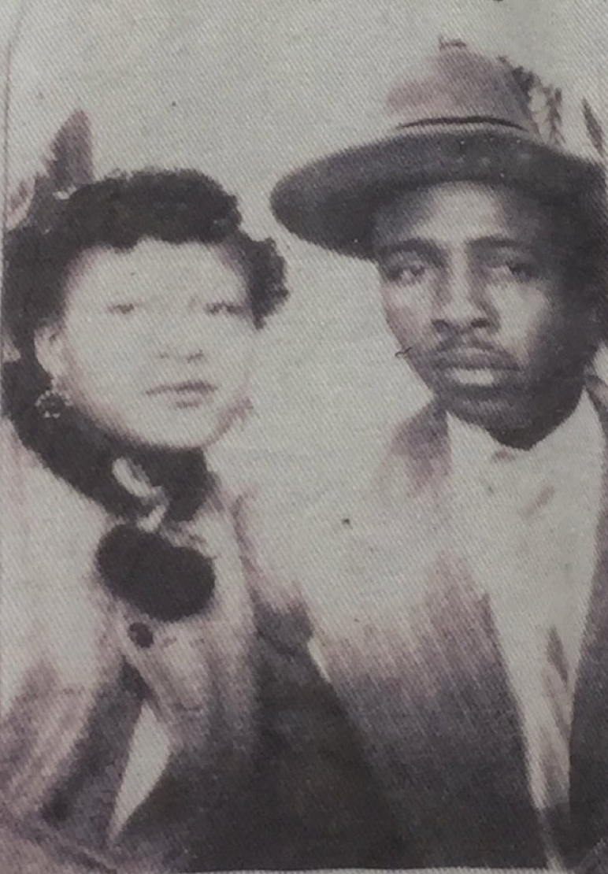
What’s Your WHY?
SUBHEADING
As a nonprofit executive leader,
I AM living their wildest dream!
My maternal grandparents
Lewis Carter Parker, Sr.
and
Irma Delois Parker

Slide 4
Have You Ever???
SUBHEADING
Story

Slide 5
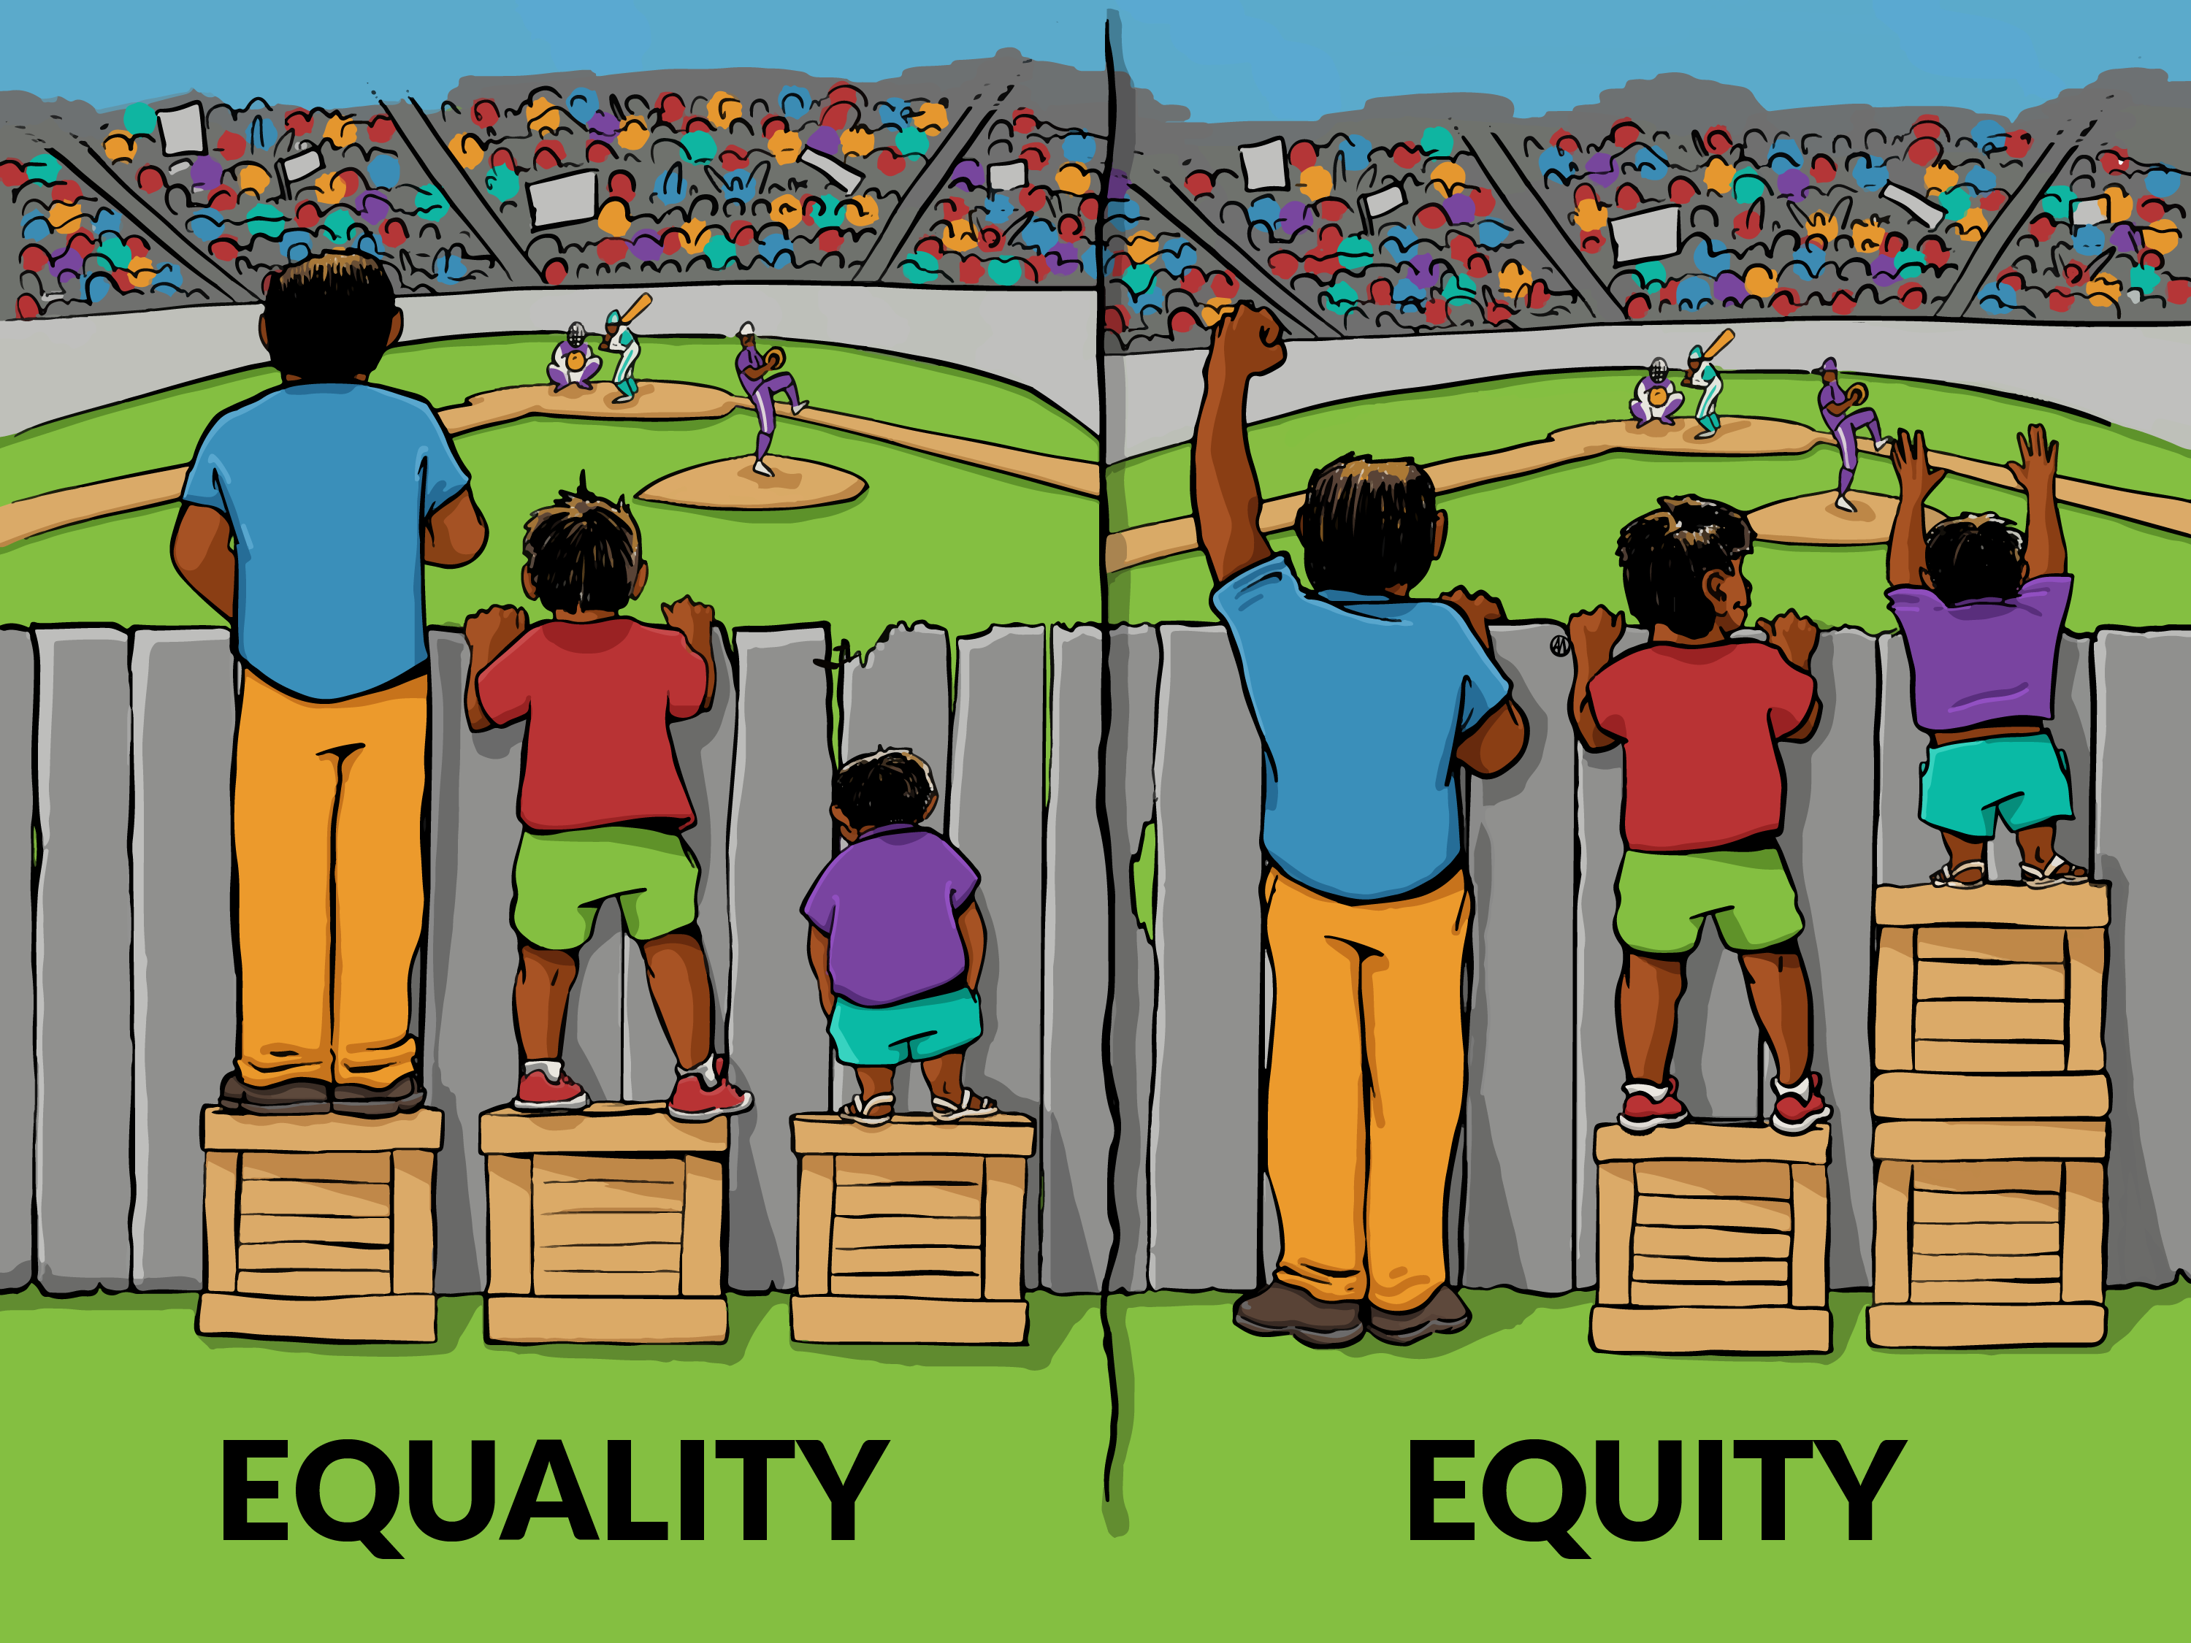
SUBHEADING

Slide 6
Equality vs. Equity
Equity is not about everyone receiving the same thing (that is equality). Equity takes into account that not everyone is at the same starting point, and perhaps different tools and interventions are needed for different groups, in order to get them to the same endpoint.
SUBHEADING

Slide 7
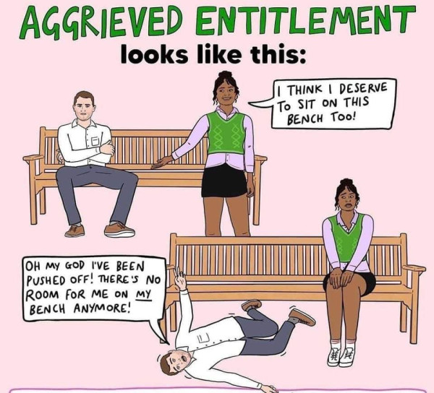

Slide 8
“Whataboutism”
The last few years have seen a huge rise in aggrieved entitlement or “Whataboutism”. #AllLivesMatter, #NotAllMen, and #WhiteLivesMatter are all examples of this, all serving to polarize communities and distract from the original issues at hand.

Slide 9
Small Group Discussion Question
Is fundraising rooted in institutional racism?
Why or why not?
Story

Slide 10
So You Want to be a Disruptor?
Be prepared to manage up, down, out and around
Level set your expectations
Pause and think about the change before making it
Things to consider:
Is it client-centered?
Is it trauma informed?
Is it equitable for everyone?
Focus on the early adopters, not the dissenters
u

Slide 11
So You Want to be a Disruptor?
Make sure ALL leaders are leading by example
Expect it to be uncomfortable
Communicate openly and often with your champions
Know on which hills you’re willing to “die”
Have a strong support system
Understand that you won’t change everyone’s mind
Remember that you can’t undo decades of action overnight…
or in one 3-5 year strategic plan!
u

Slide 12
Scenario
A major donor informs you that she will no longer support your organization because the newly hired CEO is black and was only hired because of “wokeness”. She also expresses that she wants a refund of prior donations. How would you respond?
Story

Slide 13
Story

Slide 14
Practical Ways to Move the Needle
Look for aspects of racism in your fundraising events, collateral and development plan
Examine your internal policies and practices
Recommend champions to serve on your board
Review your vendor list through an equity lens
Ensure that visual data is reflects diversity
Analyze your organizational chart for disparity

Slide 15
Reflection Question
What is one thing that you will do in the future to disrupt racism and/or unethical behavior in your organization?

Slide 16
Questions?

Slide 17
References
https://www.shl.com/resources/by-type/blog/2023/why-embracing-equity-is-key-to-organizations-dei-strategies/
https://m.facebook.com/profile.php?id=100066531380061&_rdr
https://www.huffpost.com/entry/black-woman-racism-privilege_n_613b9ea2e4b00ff836ec9480

Slide 18
Christina J. Allen, J.D.
Ceo – Familytime crisis & counseling center
Photo Caption
Body Copy
callen@familytimeccc.org
346-220-8205
Gc.edu

